Slide 1

MATH30
Probability and Statistics

Slide 2

Statistical Hypothesis
Definition 10.1

Slide 3
The Null and Alternative Hypothesis
Null Hypothesis
This refers to any hypothesis we wish to test and is denoted by H₀.
Alternative Hypothesis
Rejection of H₀
Denoted by H₁ (sometimes H_{a})
Example:
If H₀ is the null hypothesis p = 0.5 for a binomial population, the alternative hypothesis H₁ would be one of the following:
p > 0.5, p < 0.5, or, p ≠ 0.5.

Slide 4
Testing a Statistical Hypothesis
Definition 10.2
Definition 10.3

Slide 5
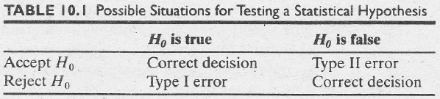
Testing a Statistical Hypothesis
The probability of committing a type I error, also called the level of significance, is denoted by the Greek letter α.
The probability of committing a type II error is denoted by β. It is impossible to compute unless we have a specific alternative hypothesis.

Slide 6


Testing a Statistical Hypothesis
Definition 10.4
Definition 10.5

Slide 7
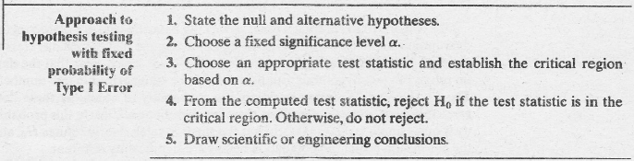
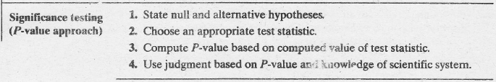
Testing a Statistical Hypothesis

Slide 8


One- and Two-Tailed Tests
A test of any statistical hypothesis, where the alternative is one-sided, such as
is called a one-tailed test.
A test of any statistical hypothesis where the alternative is two-sided, such as
is called a two-tailed test, since the critical region is split into two parts.

Slide 9
How Are the Null and Alternative Hypotheses Chosen?
Null hypothesis
Always stated using the equality sign so as to specify a single value.
Alternative hypothesis
Suggests a simple direction such as more than, less than, superior to, inferior to, and so on.
Stated using the inequality symbol (< or >).
If no direction is suggested by the claim, it is stated by the not equal symbol (≠).

Slide 10

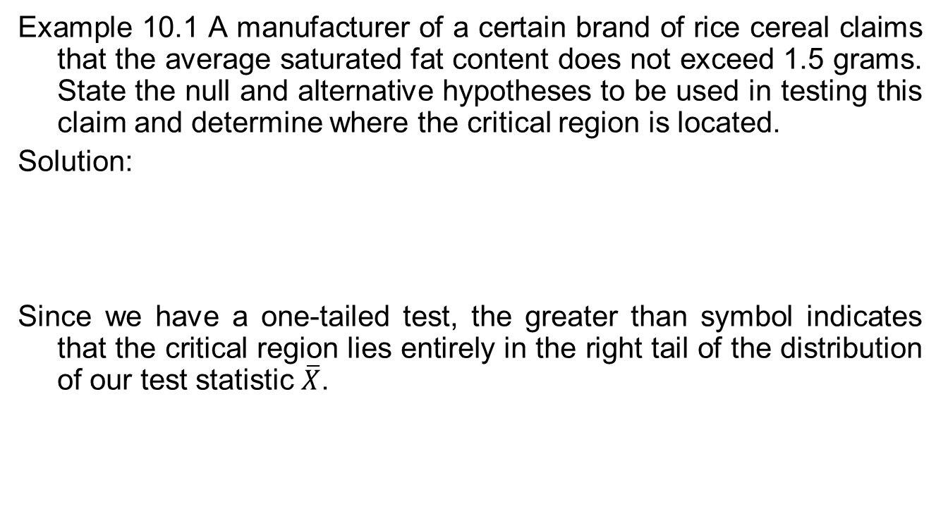
How Are the Null and Alternative Hypotheses Chosen?
Example 10.1 A manufacturer of a certain brand of rice cereal claims that the average saturated fat content does not exceed 1.5 grams. State the null and alternative hypotheses to be used in testing this claim and determine where the critical region is located.
Solution:
Since we have a one-tailed test, the greater than symbol indicates that the critical region lies entirely in the right tail of the distribution of our test statistic $\overline{X}$.

Slide 11
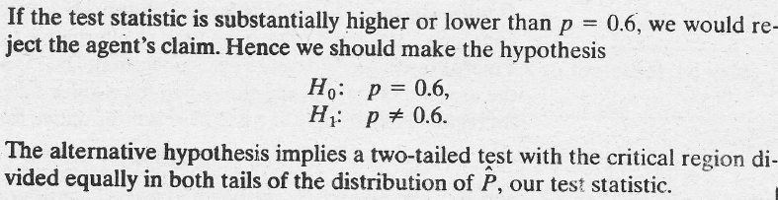
How Are the Null and Alternative Hypotheses Chosen?
Example 10.2 A real state agent claims that 60% of all private residences being built today are 3-bedroom homes. To test this claim, a large sample of new residences is inspected; the proportion of these homes with 3 bedrooms is recorded and used as test statistic. State the null and alternative hypotheses to be used in this test and determine the location of the critical region.
Solution:

Slide 12
The Four-Step Solution
Solving problems involving tests of hypotheses uses a four-step solution. The four steps are:
State the Null Hypothesis (H₀) and the Alternative Hypothesis (H₁ or H_{a}).
Determine the tabular value of Z_{t} or t_{t}.
Determine the computed value of Z_{c} or t_{c}.
State the conclusion.

Slide 13
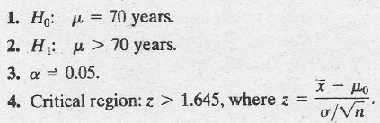
Single Sample: Tests Concerning a Single Mean (Variance Known)
Example 10.3 A random sample of 100 recorded deaths in the United States during the past year showed an average life span of 71.8 years. Assuming a population standard deviation of 8.9 years, does this seem to indicate that the mean life span today is greater than 70 years? Use a 0.05 level of significance.
Solution:

Slide 14
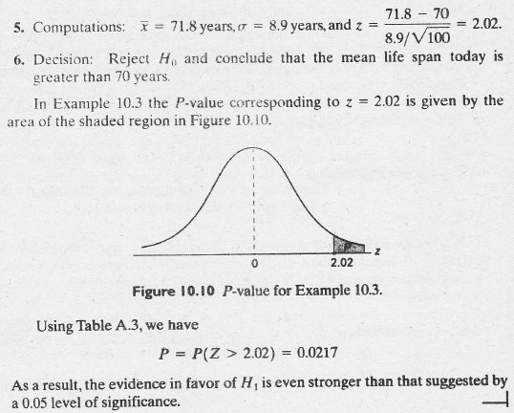
Single Sample: Tests Concerning a Single Mean (Variance Known)

Slide 15
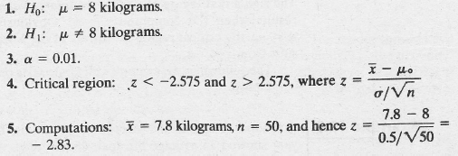
Single Sample: Tests Concerning a Single Mean (Variance Known)
Example 10.4 A manufacturer of sports equipment has developed a new synthetic fishing line that he claims has a mean breaking strength of 8 kilograms with a standard deviation of 0.5 kilogram. Test the hypothesis that μ = 8 kilograms against the alternative that μ ≠ 8 kilograms if a random sample of 50 lines is tested and found to have a mean breaking strength of 7.8 kilograms. Use a 0.01 level of significance.
Solution:

Slide 16
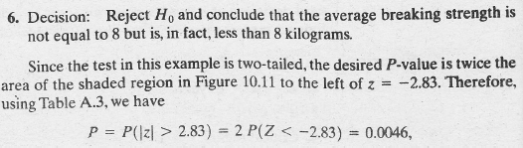
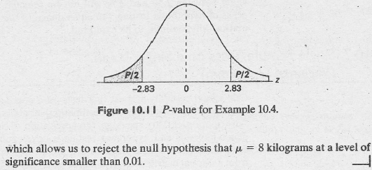
Single Sample: Tests Concerning a Single Mean (Variance Known)

Slide 17

Single Sample: Tests Concerning a Single Mean (Variance Unknown)
Test t-statistic for a test on a single mean (variance unknown)

Slide 18

Single Sample: Tests Concerning a Single Mean (Variance Unknown)
Example 10.5 The Edison Electric Institute has published figures on the annual number of kilowatt-hours expended by various home appliances. It is claimed that a vacuum cleaner expends an average of 46 kilowatt-hours per year. If a random sample of 12 homes included in a planned study indicates that vacuum cleaners expend an average of 42 kilowatt-hours per year with standard deviation of 11.9 kilowatt-hours, does this suggest at the 0.05 level of significance that vacuum cleaners expend, on the average, less than 46 kilowatt-hours annually? Assume the population of kilowatt-hours to be normal.
Solution:

Slide 19
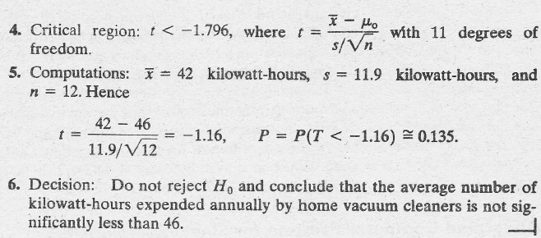
Single Sample: Tests Concerning a Single Mean (Variance Unknown)

Slide 20
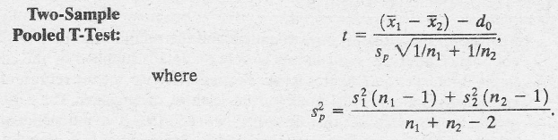
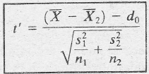

Two Samples: Tests on Two Means
Unknown Variances
Unknown But Unequal Variances
Approximate degrees of freedom

Slide 21
Two Samples: Tests on Two Means
Example 10.6 An experiment was performed to compare the abrasive wear of two different laminated materials. Twelve pieces of material 1 were tested by exposing each piece to a machine measuring wear. Ten pieces of material 2 were similarly tested. In each case, the depth of wear was observed. The samples of material 1 gave an average (coded) wear of 85 units with a sample standard deviation of 4, while the samples of material 2 gave an average of 81 and a sample standard deviation of 5. Can we conclude at the 0.05 level of significance that the abrasive wear of material 1 exceeds that of material 2 by more than 2 units? Assume the populations to be approximately normal with equal variances.

Slide 22
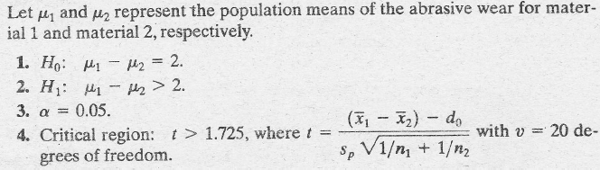
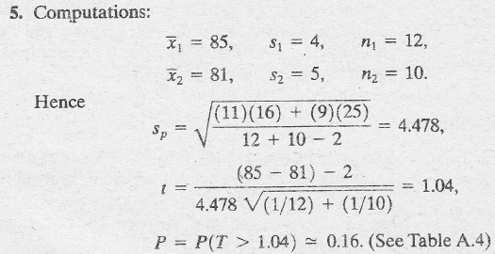
Two Samples: Tests on Two Means
Solution:

Slide 23
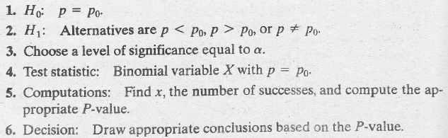

One sample: Test on a Single Proportion
Testing a proportion: small samples
z-value for testing p = p₀

Slide 24
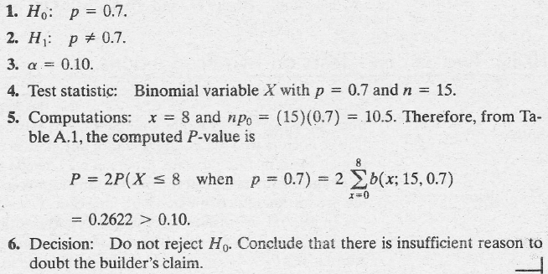
One sample: Test on a Single Proportion
Example 10.10 A builder claims that heat pumps are installed in 70% of all homes being constructed today in the city of Richmond. Would you agree with this claim if a random survey of new homes in this city shows that 8 out of 15 had heat pumps installed? Use a 0.10 level of significance.
Solution:

Slide 25
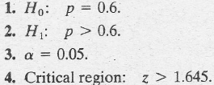
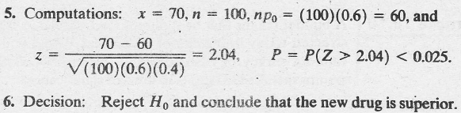
One sample: Test on a Single Proportion
Example 10.11 A commonly prescribed drug for relieving nervous tension is believed to be only 60% effective. Experimental results with a news drug administered to a random sample of 100 adults who were suffering from nervous tension show that 70 received relief. Is this sufficient evidence to conclude that the new drug is superior to the one commonly prescribed? Use a 0.05 level of significance.
Solution:

Slide 26


Two Samples: Tests on Two Proportions
Pooled estimate of the proportion p
z-value for testing p₁ = p₂

Slide 27
Two Samples: Tests on Two Proportions
Example 10.12 A vote is to be taken among the residents of a town and the surrounding county to determine whether a proposed chemical plant should be constructed. The construction site is within the town limits and for this reason many voters in the country feel that the proposal will pass because of the large proportion of town voters who favor the construction. To determine if there is significant difference in the proportion of town voters and county voters favoring the proposal, a poll is taken. If 120 of 200 town voters favor the proposal and 240 of 500 county residents favor it, would you agree that the proportion of town voters favoring the proposal is higher than the proportion of county voters. Use an α = 0.05 level of significance.

Slide 28
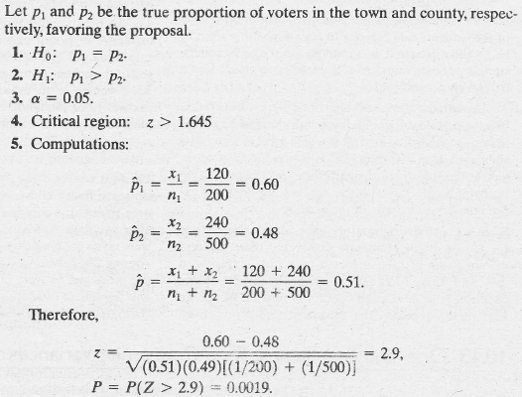
Two Samples: Tests on Two Proportions
Solution:

Slide 29
Two Samples: Tests on Two Proportions
Solution:

